Slide 1
Capstone Project: Date-A-Scientist
By Harrison Wai

Slide 2
General Exploration of Data: Review
I looked at four columns that attracted my attention, specifically “Job”, “Education”, “Diet” and “Body Type”. These columns are treated as categorical data, and so the next two slides visually show the mode of each column. I have found that majority of users:
Have graduated from college/university
Have a job of “other” with the second most popular job being a “student”.
Have diet that is “mostly anything”
Have body type that is “average”.
It is very possible that education, diet, and body type can be an accurate predictor for job type. Scatterplots is made in the next slide to show how strongly each variables correlate, to which I have augmented the data by mapping it (see Slide 6). The more frequency of occurrence between two variable the bigger the plot size marker. I have found that:
Job/Education have stronger frequency of occurrence compared to Job/Body_Type and Job/Diet.

Slide 3
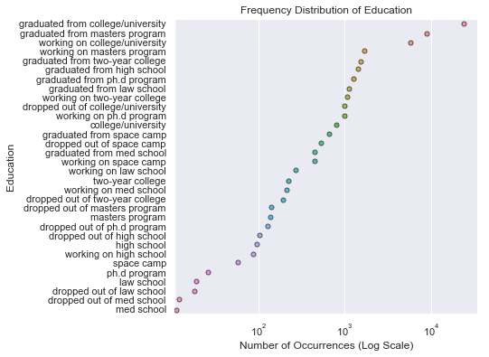
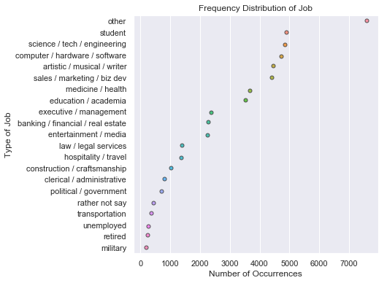
General Exploration of Dataset: Education and Job

Slide 4
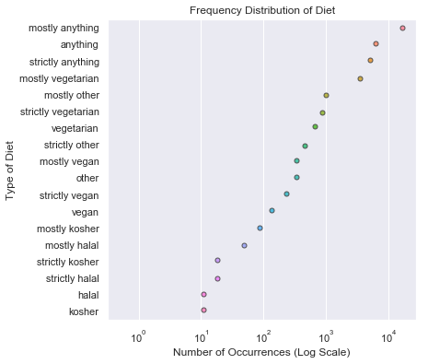
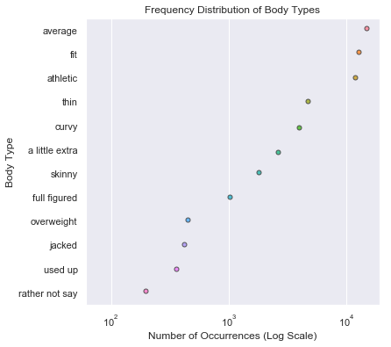
General Exploration of Dataset: Diet and Body Types

Slide 5
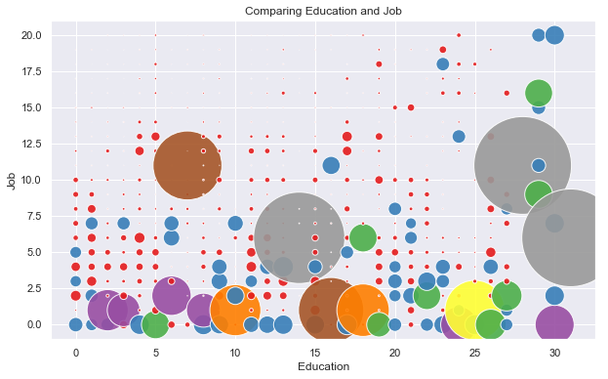
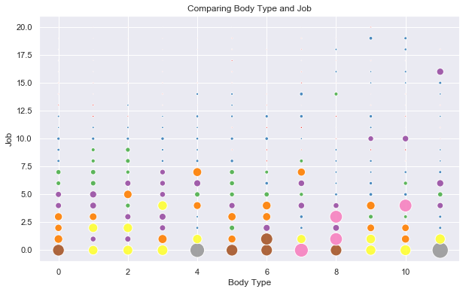
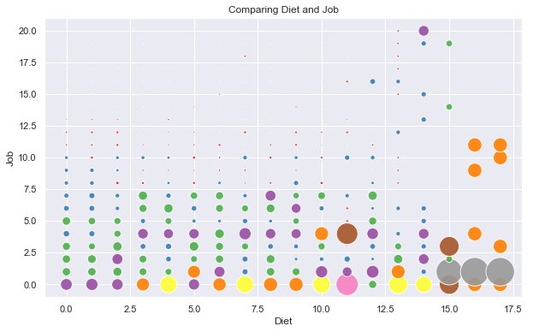
General Exploration of Augmented Dataset

Slide 6
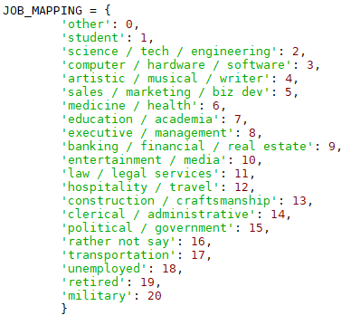
Data Maps (or Augmenting Data)
The four aforementioned columns (“Job”, “Education”, “Body Type” and “Diet) were mapped in order to visually examine the relationship of each column in the previous slide.
This can be done by finding specific text in the column by .value_counts(), and the image on the right is an example of how one maps the text (e.g. ‘x’: n).
In addition, this is also done for applying machine learning fundamental techniques such as KNN and Naive Bayes Classifier.

Slide 7
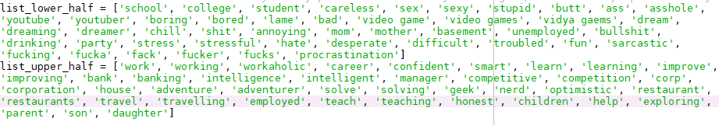
General Exploration of Dataset: Income vs Choice of Words (essay0-essay9)
I investigated the column “income” and there are quite a lot of “-1”, so I have removed the rows that contained -1 in that column. I have created two arbitrary word list that I believe what higher and lower income user would use, for example, lower income user would use negative adjective such as ‘bad’ or noun that would usually associate with lower income such as ‘youtuber’ (I do not think Youtuber earn a lot of money).
The next slide show graphs comparing income to the number of times specific words (see below) were used in all of the essay, although it is not quite distinctive as I had imagined.

Slide 8
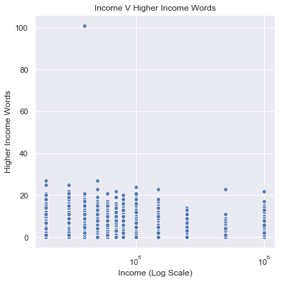
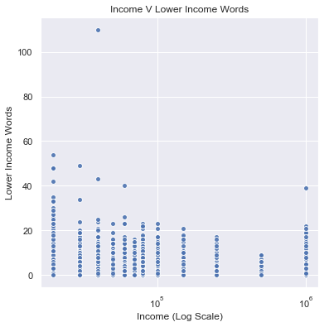
General Exploration of Dataset: Income vs “Income Words”

Slide 9
Formulated Questions
After exploring different datasets and augmented some data, I have decided to formulate two questions. Afterward, we will apply the machine learning fundamental techniques to see the results.
Question 1 (Classification Problem): Can we accurately predict users’ type of job based on their body type, diet and education?
Question 2 (Regression Problem): Can we accurately predict users’ income based on their choice of words (determined by me) used in their essay?

Slide 10
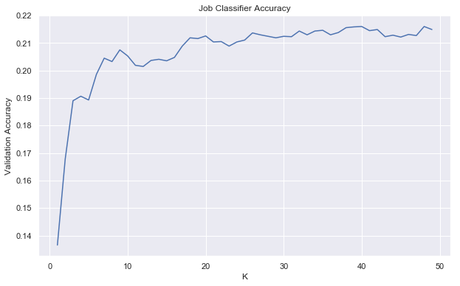
Question 1: Can we accurately predict users’ type of job based on their body type, diet and education?
This question is a classification problem, and KNN and Naive Bayes Classifier was used to tackle it:
KNN Classifier had an accuracy of ~21%.
Naive Bayes Classifier had an accuracy of ~12%.
They are not very good at predicting the user’s type of job based on their education, body type and diet.
This is surprising to me.

Slide 11
Question 2: Can we accurately predict users’ income based on their choice of words (determined by me) used in their essay?
This question is a regression problem, and so the data was ran via a linear regression model to predict the user's’ income based on the arbitrary word list that I have created myself.
Using linear regression model yielded an accuracy of ~0.09%, which means that user usage from word lists is not an accurate way to predict income.
I was shocked.

Slide 12
Thoughts and conclusion
Review on Question 1:
I was surprised that the accuracy was really low (KNN ~21%, NBC ~12%). I think that if I were to do it again, I would really like the job “other” to be removed, as it is meaningless information to me and most likely had an affect on the result. I just realized that age could be another reliable predictor for job, not sure why I did not include it in the first place.
Review on Question 2:
I was again surprised that the accuracy was pretty much 0%. When that result occurred, I went back and individually scanned the essays myself. I learned that, some people like to falsify their income, i.e. 1000000, and some like to use “higher income words” even when they have lower income. My linear regression model to predict someone’s income based on word lists is really bad. If I had to improve it, I should have sorted the users by income, then generate top 10 - 30 words each different income users used, maybe that would have been a better way to make my model accurate. Furthermore, preferably less user who has given “-1”.

